Slide 1

Data Science Fy16-ds-pod-Arganesa
Understanding the factors that drive high Yelp Restaurant Ratings
Notes:
Mike

Slide 2






The Data Scientists
Marilyn Langley Sr. Test Engineer | Mike Gadish Sr. Supply Chain Manager | Trieu Pham Business Analyst | Karpakam Rajagopalan ARCHITECT IT | Che Tang Program Management IT.
Notes:
Mike

Slide 3
AGENDA Business Case Goals and Objectives Data Preparation YELP Data Findings Key Challenges and Learning's
Notes:
Mike

Slide 4

Business Case
Overall ratings and areas for improvements can provide a benefit to the businesses leveraging data analytics:
Secure and extract all “Restaurants”
Based on data find areas of improvement to generate greater revenue/foot traffic
Provide areas of recommendations: Which services would be good to offer to increase ratings i.e.; reservations, wi-fi or valet parking
Leveraged Harvard Business Reviews on current landscape of Yelp to ensure we solve a true business case.
Notes:
Mike

Slide 5
Potential Business Benefits
Show steps vs. Objectives
Utilize lessons from Data Science class to determine the Yelp data attributes that could result in greater reviews among restaurants
Pre-Lim Excel – Colum’s classifications
Investigated a Linear Model
Investigated Text Analytics
Association Rule Mining
Random Forest model to rank the importance of the different attributes
Identification of or areas for Restaurant Improvement
Present Opportunities to Restaurants
Value add for Yelp sales department
Improved Customer Experience for both Yelp and Restaurant
Notes:
Mike

Slide 6

Data Preparation
Data Access
Data Cleaning
Notes:
Trieu

Slide 7
Data Access
5 files for YELP analysis
Businesses – 105 Columns – Can be categorized by# ID, name, categories (list), review count, stars,
city, neighborhoods, address, latitude, longitude, state/province, various attributes (ambiance, parking, hair type and hours)
*This was the greatest set of data to meet our objective
Reviews – 10 Columns- Text of Yelp reviews
Tips - 6 Columns – Shorter comments by users
Users – 23 Columns – Profiles of the user base
Check-ins - 170 Columns – Frequency of visits
Notes:
Trieu

Slide 8

Business - Data Exploration
Bias – to only review Bay Area rest – Data only provides a limited count as 3 businesses
Bias – only wanted to review rest’s as an assumption that rest’s would be the largest data set
Selected businesses categories that were classified as “Restaurants”
Addressed 22K of restaurants
Ran the statistics of the star data set
What were the challenges of cleaning the data and or using the data? What are the elements that were missing?
Notes:
Trieu

Slide 9
Yelp Data Preprocessing
Dealing with the “categories” column
selecting restaurants
Handling NA values
Combining hours of operation
Binning continuous variables
latitude/longitude, review count
Transformed “stars” to “highly rated”
4 or more stars, or not?
Excluding irrelevant columns
Notes:
Marilyn

Slide 10

YELP DATA FINDINGS
Association Rule Mining
Random Forest
General Linear Regression
Challenges and Findings
Notes:
Kar

Slide 11
Association Rule Mining
# of users (366,715)
Leveraged the apriori method to determine the association rules between the data elements in the Yelp Business Data confined only to restaurants
Generated 1022 rules
Based on our requirement to identify attributes that impacted the restaurants to have “High” /”Low” rating, apriori was confined to rules that resulted in “High”/ “Low” rating
30 rules were generated around attributes that led to “High” rated restaurants
41 rules were generated around attributes that led to “Low” rated restaurants
Not all rules make sense , leveraged tools , tips and techniques to identify the right set of rules that is applicable to our business problem
Higher values of parameters like support, confidence and lift helped identify the right set of rules
# of reviews (1,569,264)
# of tips (495,107)
# of check-in (45,166)
Notes:
Kar

Slide 12
➔ Do weekend hours matter?
# of Restaurants | Open Sat | Open Sun | Open Sat / Sun | Open Both Sat & Sun
Total 5 Stars = 389 | 208 || 53.5% | 142 || 36.5% | 208 || 53.5% | 142 || 36.5%
Total 4 Stars = 8,130 | 5724 || 70.4% | 4841 || 59.5% | 5745 || 70.7% | 4820 || 59.3%
Total 3 Stars = 9,987 | 5850 || 58.6% | 5378 || 53.9% | 5861 || 58.7% | 5367 || 53.7%
Total 2 Stars = 2,961 | 962 || 32.5% | 898 || 30.3% | 972 || 32.8% | 888 || 30.0%
Total 1 Stars = 425 | 68 || 16.0% | 65 || 15.3% | 68 || 16.0% | 65 || 15.3%
Analysis: Businesses with operating hours during the weekend generally have a greater changes of receiving a higher star rating. One suggestion to business owners is to have weekend hours!
Notes:
KAR
Exclude outliers
Feature Selection Methods from Mandar.
Text Analysis vs Categorical/Value analysis.
Exploratory analysis – what features/characters make a restaurant a better rating? Bi-Clustering? What type of characteristic leads to a better rating?
Only focus on Text or Numerical data?

Slide 13
➔ Will accepting credit cards help their star rating?
# of Restaurants | Accept CC | Percentage
Total 5 Stars = 389 | 282 | ~72.5%
Total 4 Stars = 8,130 | 7216 | ~88.8%
Total 3 Stars = 9,987 | 9159 | ~91.7%
Total 2 Stars = 2,961 | 2602 | ~87.9%
Total 1 Stars = 425 | 330 | ~77.6%
Analysis: Acceptance of credit card does not appear to be a statistically significant factor in business star rating.
Notes:
KAR
Exclude outliers
Feature Selection Methods from Mandar.
Text Analysis vs Categorical/Value analysis.
Exploratory analysis – what features/characters make a restaurant a better rating? Bi-Clustering? What type of characteristic leads to a better rating?
Only focus on Text or Numerical data?

Slide 14
➔ Which of these other factors may have a significant effect on star rating?
# of Restaurants | Valet Parking | Free Wi-Fi | Reservations | Waiter Service | Review Count >= 10 | Review Count >= 100 | Delivery
Total 5 Stars = 389 | 2 || 0.5% | 71 || 18.3% | 116 || 29.8% | 137 || 35.2% | 99 || 25.5% | 6 || 1.6% | 64 || 16.5%
Total 4 Stars = 8,130 | 277 || 3.4% | 2045 || 25.2% | 2925 || 36.0% | 4563 || 56.1% | 5688 || 70.0% | 1531 || 18.8% | 1300 || 16.0%
Total 3 Stars = 9,987 | 294 || 2.9% | 2275 || 22.9% | 3319 || 33.2% | 5700 || 57.1% | 6848 || 68.6% | 1030 || 10.3% | 1714 || 17.2%
Total 2 Stars = 2,961 | 41 || 1.4% | 436 || 14.7% | 543 || 18.3% | 1184 || 40.0% | 1312 || 44.3% | 67 || 2.3% | 489 || 16.5%
Total 1 Stars = 425 | 2 || 0.5% | 47 || 11.1% | 30 || 7.1% | 68 || 16.0% | 76 || 17.9% | 3 || 0.7% | 58 || 13.7%
Analysis: Valet parking and Delivery are not likely to improve rating, while having waiter service and a significant review count may help. Two factors that stand out are offering free wi-fi and accepting reservations.
Notes:
KAR
Exclude outliers
Feature Selection Methods from Mandar.
Text Analysis vs Categorical/Value analysis.
Exploratory analysis – what features/characters make a restaurant a better rating? Bi-Clustering? What type of characteristic leads to a better rating?
Only focus on Text or Numerical data?

Slide 15
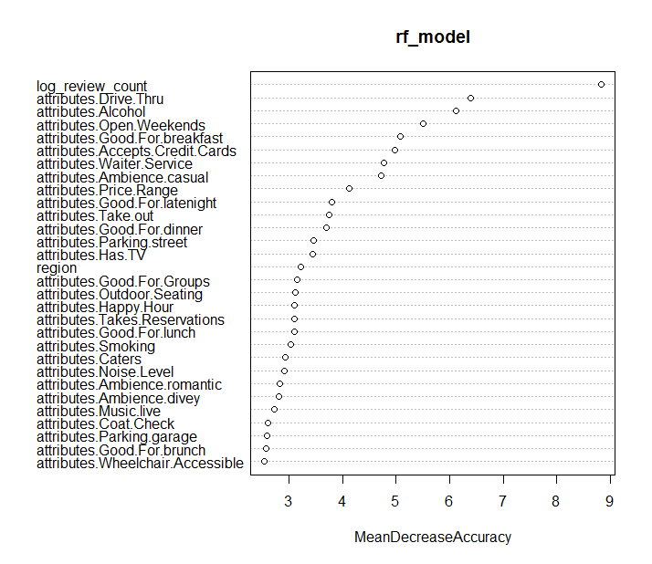
Random Forest
Notes:
Mar

Slide 16
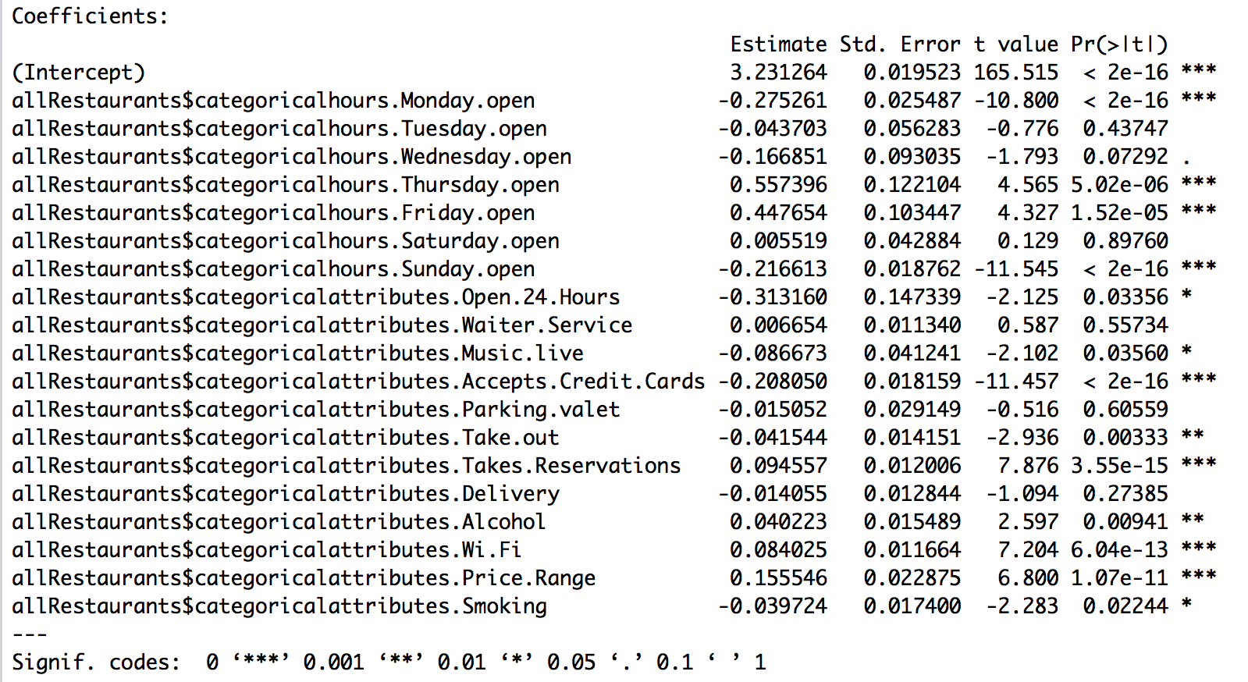
Generalized Linear Model
Executed the model against a number of predictors.
The results of GLM captures our expectation.
Both predictors are not a factor in star rating…matched our expectation via the manual analysis.
These predictors are relevant to improving the star rating…matched our expectation via the manual analysis.
Opening Sunday has greater importance to patrons.
After reviewing GLM result, we realize we have incorrectly interpreted our manual analysis.

Slide 17
Key Challenges and Learnings
Based on the three models – General Linear Regression Model was the most applicable
Determining meaningful association rules was challenging because of missing data and associations that led to conflicting rules
Text Analytics did not provide meaningful results.
The data prep phase took more time then we expected- take this into account when building project timelines
Accurate predictive models can’t always be built with the data available
Simple profiling and exploratory data analysis may reveal more useful nuggets then prediction and classification models
Assemble a diverse team – as each member will think about problems in different ways and apply different approaches to solving them
Determining meaningful association rules was challenging because of missing data and associations that led to conflicting rules
Notes:
MIke

